Slide 1
First Term Success Workshop
Advancement
Notes:
FACILITATOR GUIDE:
Career Planning has many facets, setting goals and expectations for yourself will push you to be your best version.

Slide 2
Enabling Objectives
IDENTIFY Navy Wide Advancement eligibility per the Advancement Manual for Enlisted Personnel of the U.S. Navy and U.S. Navy Reserve, BUPERSINT 1430.16 (series)
DEFINE Time in Service
DEFINE Time in Rate
LIST Advancement paths available for E1 to E6
IDENTIFY billet based advancement opportunities
Notes:
FACILITATOR GUIDE:
Review objectives

Slide 3
References
BUPERSINST 1430.16(Series)- Advancement Manual for Enlisted Personnel of the U.S. Navy and U.S. Navy Reserve
MILPERSMAN 1430-010- Accelerated Advancement of Recruit Training, Class “A” School Graduates, and Ceremonial Guard
MILPERSMAN 1430-020- Advancement After Reduction in Rate
MILPERSMAN 1510-030- Advanced Electronics Field, Advanced Technical Field, And Nuclear Field Programs
NAVADMIN 111/24- Implementation of Command Advance to Position
NAVADMIN 017/24- Detailing Marketplace Assignment Policy Phase IV- DC and ABE exclusive
NAVADMIN 237/23- Updates to the Navy Enlisted Leader Development Program
Notes:
FACILITATOR GUIDE:
Review references

Slide 4
References
NAVADMIN 200/17- Commanding Officer Authority to Reinstate up to E4 Rank and Elimination of E4 Advancement Exams for 20 Ratings with Accelerated Advancement
MILPERSMAN 1160-100 Selective Training and Reenlistment (STAR) Program
Career School Listing (CSL)-https://www.mynavyhr.navy.mil/Career-Management/Community-Management/Enlisted-Career-Admin/SRB-SDAP-Enl-Bonus/Career-School-Listing
Detailing Marketplace Assignment Policy (DMAP) page- https://www.mynavyhr.navy.mil/Career-Management/Detailing/Enlisted /Detailing-Marketplace
Distribution Guidance Memorandum (DGM) 4092-2206
Notes:
FACILITATOR GUIDE:
Review references

Slide 5
Advancement Eligibility
Eligibility
  Must be recommended by CO
  Be in proper path of advancement
  Have completed the Professional Military Knowledge – Eligibility Exam (PMK-EE) for the next paygrade
  (E-5 through E-7 paygrades)
  *Beginning calendar year 2025, Enlisted Leader Development (ELD) is required for E6 and E7 advancement, not yet requirement for E5.
Notes:
FACILITATOR GUIDE:
Specify the exam cycle NAVADMIN PMK-EE completion deadline and that it must be completed by the deadline or the Sailor will render themselves ineligible for the advancement exam.
Must be recommended by CO (Promotable evaluation or higher)

Slide 6
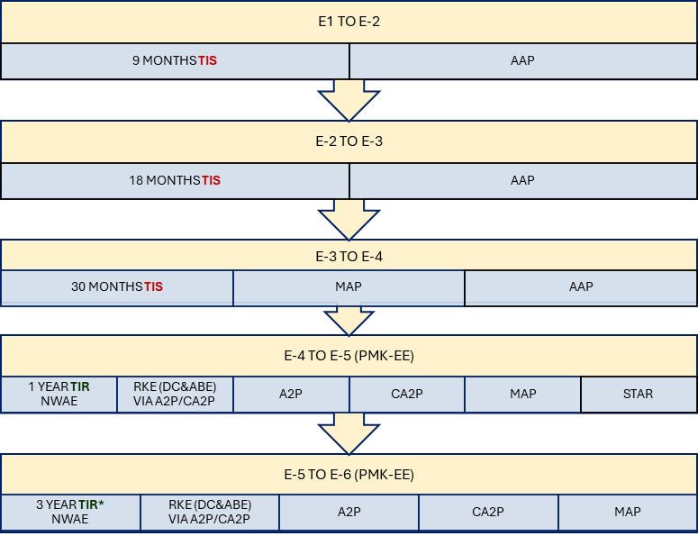

E1 to E6 Advancement
Notes:
FACILITATOR GUIDE:
Let’s examine each paygrade advancement one, at a time.

Slide 7
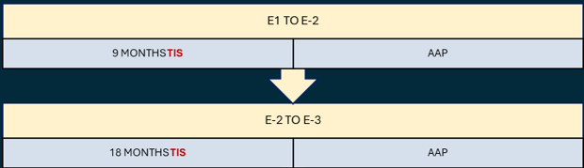
E1 to E3 Advancement
TIS- Time-In-Service
  E1 to E2 is 9 months TIS/E2 to E3 is 18 months TIS
AAP- Accelerated Advancement Program
  CO, Navy Recruit Training Command may advance top 10% of each graduating class to next higher paygrade
  COs of traditional/nontraditional school may advance #1/top 5% of graduates in each class to next higher paygrade (not to exceed E3)
  Ceremonial Guard and Advanced Electronics/Technical/Nuclear Fields advancement
Notes:
FACILITATOR GUIDE:
TIS is accumulative
CO of RTC may advance top 10% of each graduating class to next higher paygrade (E2 or E3).
COs of traditional schools may advance #1 “A” school graduate in each class to next higher paygrade (not to exceed E3)
COs of non-traditional school may advance top 5% of “A” school graduates in each class to next higher paygrade (not to exceed E3)
CO of ceremonial guard may advance all Sailors who complete ceremonial guard indoctrination to E3.
AEF, ATF, NF (ADVANCED ELECTRONICS FIELD, ADVANCED TECHNICAL FIELD, AND NUCLEAR FIELD PROGRAMS) AAP:
Rates in program include:
AEF- AECF, ET, FC, FCA, CTM, CTT, MT, STG
ATF- AWF, AWR, AWS, AWO, AWV, CTI, CWT (formally CTN), EOD, IC, IS, IT, ITS, ND, SB, SO, HM L00A, HM L02A, HM L27A
NF-MMN, MT, ND, SB, SO
Advanced Electronics Field (AEF), Advanced Technical Field (ATF), and Nuclear Field (NF) Programs provide advancement incentives for additional obligated service due to longevity of training required.

Slide 8
E3 to E4 Advancement
TIS- E3 to E4 is 30 months
AAP- Accelerated Advancement Program
  COs of traditional/nontraditional school may advance top 10% of graduates in each class to E4, regardless of current paygrade. (observation period & additional obligated service)
  Advanced Electronics/Technical and Nuclear Fields require 6 months TIR as E3 and successful completion of training to advance to E4
Notes:
FACILITATOR GUIDE:
Total time-in-service (TIS) to advance to E-4 is 30 months for all Sailors regardless of entry rank. A Sailor who joins as an E-2 will advance to E-3 after 18 months TIS and then to E-4 at 30 months total TIS. A Sailor who joins as an E-3 will advance to E-4 at 30 months total TIS. An example is a Sailor joins as an E-3 on Sept 1, 2024 – they will be an E-4 on March 1, 2027.
Refer to NAVADMIN 111/24
NON-AEF, ATF, NF AAP to E4
The accelerated advancement will be held in abeyance for 4 to 10 months from report date to ultimate duty station. (N/A to Advanced Electronics/Technical/Nuclear Fields)
Members must incur additional year of obligated service, and meet all other advancement requirements (except TIS) and be recommended by CO.
AEF, ATF, NF (ADVANCED ELECTRONICS FIELD, ADVANCED TECHNICAL FIELD, AND NUCLEAR FIELD PROGRAMS) AAP:
Rates in program include:
AEF- AECF, ET, FC, FCA, CTM, CTT, MT, STG
ATF- AWF, AWR, AWS, AWO, AWV, CTI, CWT (formally CTN), EOD, IC, IS, IT, ITS, ND, SB, SO, HM L00A, HM L02A, HM L27A
NF-MMN, MT, ND, SB, SO
Rates typically incur longer OBLISERV requirements at time of acceptance into program
Authorized advancement to E4 after successful completion of training and serving 6 months TIR as an E-3

Slide 9
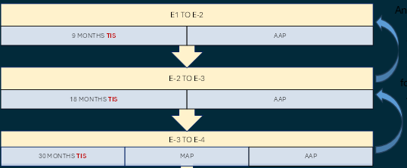
Reduction
Any reduction in paygrade requires regaining advancement recommendation, 6 months at each following paygrade to E4 or meet TIS gates (whichever is greater)
Notes:
FACILITATOR GUIDE:
Refer to MILPERSMAN 1430-020- Advancement After Reduction in Rate and NAVADMIN 111/24

Slide 10



E4 to E5 Advancement
Must complete PMK-EE (Professional Military Knowledge Eligibility Exam) for E5 advancement, all routes!
Complete on App or Navy eLearning
Notes:
FACILITATOR GUIDE:

Slide 11
E4 to E5 Advancement
NWAE (Navy Wide Advancement Exam)- E4 to E5 is 1 year TIR (Time-in-rate)
  TIR= date from which candidate’s total service in paygrade is considered to have commenced for the purpose of computing advancement eligibility for the next higher paygrade
  Requires signing EAW (Electronic Advancement Worksheet) prior to exam
PAYGRADE | ADVANCED OR ENTRY DURING THE | ASSIGN TIR DATE
E4-E6 | 1 JAN-30 JUN | 1 JANUARY OF CURRENT YEAR
 | 1 JUL-31 DEC | 1 JULY OF CURRENT YEAR
Notes:
FACILITATOR GUIDE:
Refer members to pamphlet for QR code and links on how to complete EAW.

Slide 12
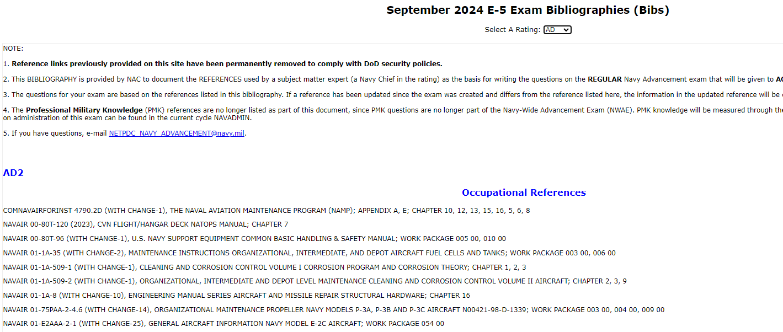
E4 to E5 Advancement
  Head to: https://www.cool.osd.mil to access bibliographies and subtopics to prepare for NWAE!
Notes:
FACILITATOR GUIDE:

Slide 13
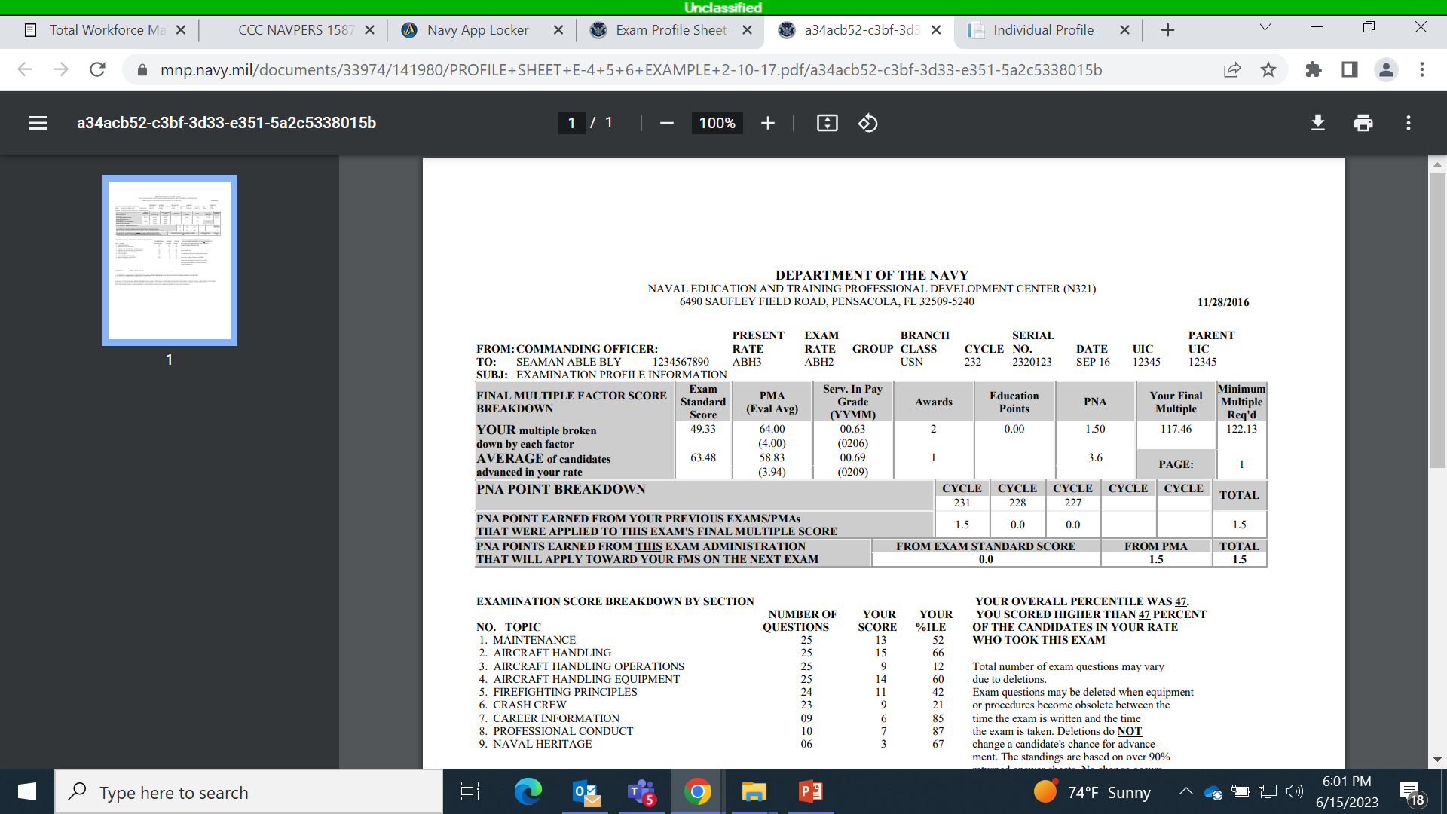
Exam Profile Sheet
Your Profile sheet provides the results from the advancement exam
Final Multiple Score (FMS)
Passed Not Advanced Points (PNA)
https://www.nsips.cloud.navy.mil/my.policy. In the Training, Education and Qualifications tab, click on "View Training, Education and Qualifications." Click on "Exam Profile Data​”
Notes:
FACILITATOR GUIDE:
Presenter can explain how the EAW works to provide specify information on the Profile Sheet; can breakdown the columns on here for the FMS calculation. Presenter can also explain how to add an email to receive Profile Sheet Update notifications via BOL.

Slide 14
E4 to E5 Advancement
  RKE (Rating Knowledge Exam)
    Only applicable to DC and ABE rates currently
    Only required to pass once per paygrade then compete for billet of higher paygrade
    Used to compete for billet-based advancement (A2P/CA2P)
    Requires signing EAW (Electronic Advancement Worksheet) prior to exam
Notes:
FACILITATOR GUIDE:
All DC and ABE Sailors who were selected for advancement to E4 and E5 in Cycle 260 or have advanced via a previous cycle or program (MAP, etc.) were eligible to take the RKE for Cycle 263.
Although not required to do so, Sailors who pass the RKE may voluntarily take future RKEs to improve their marketplace score.
Refer to NAVADMIN 017/24 for more information about the RKE

Slide 15
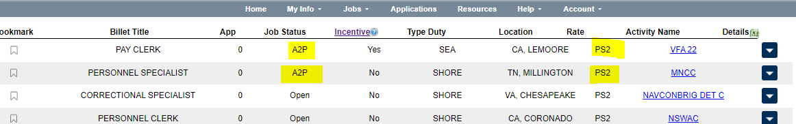
E4 to E5 Advancement
  A2P- Advance to Position
    E4 eligible (Passed E5 NWAE/RKE) applies for 3-year Journeyman assignment and advances upon arrival
    Set paygrade search in MyNavy Assignment to “4-5” to find A2P billets
Notes:
FACILITATOR GUIDE:
Must have passed E5 exam (NWAE/RKE) to be eligible
Multiple Sailors competing for the same billet will be adjudicated by Enlisted Distribution Division (PERS-40) via comparison of rating, paygrade, NEC, DMIP, Cost policy, Sailor App Ranking, Sailor’s preference, Command ranking, FMS, and sea credit. Once matched to a billet at the next higher rank, the Sailor must obligate service to complete the full tour at the new rank in the new billet via extension or reenlistment, as necessary, and may be frocked 30 days prior to transfer. Sailors will be advanced by the gaining command upon arrival in the new billet and after completion of any required training.
Refer to: Distribution Guidance Memorandum (DGM) 4092-2206 and NAVADMIN 017/24 for more information

Slide 16
E4 to E5 Advancement
  CA2P- Command Advance to Position
    An E4 eligible (passed E5 NWAE/RKE) Sailor is nominated by their CO to fill a vacant or soon to be vacant PO2 billet onboard the current sea duty activity.
    Sailor needs to be willing to add additional obligated service to fulfill tour length requirements for the higher paygrade billet
    Must have 2 years of cumulative sea duty to be eligible for CA2P for E5
Notes:
FACILITATOR GUIDE:
Must have passed E5 exam (NWAE/RKE) to be eligible
Normal additional service requirements default to 3 years. For overseas tours, service requirement must meet DoD requirements
Refer to: NAVADMIN 111/24 for more information

Slide 17
E4 to E5 Advancement
  MAP- Meritorious Advancement Program
    Command can advance Sailor to next higher paygrade without incurring additional obligated service
    Season NAVADMIN dictates TIR and rating limitations
    Limited by available quotas
    Expected to be phased out in 2 calendar years, replaced by CA2P and A2P
Notes:
FACILITATOR GUIDE:
None

Slide 18
E4 to E5 Advancement
  STAR- Selective Training and Reenlistment
    Possible advancement from PO3 to PO2 upon completion of a Class “C” School, which is listed in the Career Schools Listing (CSL).
    Must be on first enlistment, with more than 21 months active duty and less than 6 years active duty.
    No evaluation grade below 3.0 for 2 years prior to submission date
    No NJP for 18 months prior to submission
    Not be accepted for any commissioning programs
Notes:
FACILITATOR GUIDE:
MPM 1160-100 and Career School Listing (CSL)

Slide 19

E5 to E6 Advancement
  ***PMK-EE requirement remains in effect for E5 to E6*** advancement; ELD requirement beginning 2025
NWAE (Navy Wide Advancement Exam)- E5 to E6 is 3 years TIR (Time-in-rate)
    Can waive up to 1 year TIR, with EP periodic evaluation and CO’s endorsement
    Requires signing EAW (Electronic Advancement Worksheet) prior to exam
Notes:
FACILITATOR GUIDE:
None

Slide 20
E5 to E6 Advancement
RKE (Rating Knowledge Exam)
Only applicable to DC and ABE rates currently
Only required to pass once per paygrade then compete for billet of higher paygrade
Used to compete for billet-based advancement (A2P/CA2P)
Requires signing EAW (Electronic Advancement Worksheet) prior to exam
Notes:
FACILITATOR GUIDE:
None

Slide 21
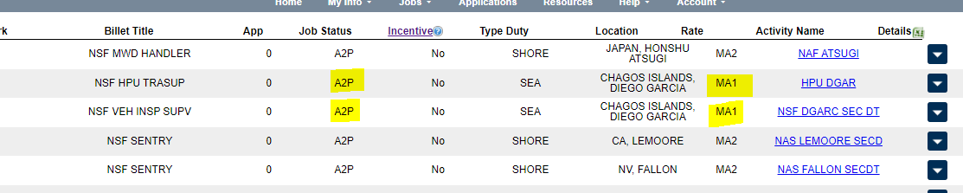
E5 to E6 Advancement
A2P- Advance to Position
E5 eligible (Passed E6 NWAE/RKE) applies for 3-year Journeyman assignment and advances upon arrival
Set paygrade search in MyNavy Assignment to “5-6” to find A2P billets
Notes:
FACILITATOR GUIDE:
None

Slide 22
Review and Summary
What are advancement requirements/paths for E3 to E4
What are advancement requirements/paths for E4 to E5
What are advancement requirements/paths for E5 to E6
Questions?
Notes:
FACILITATOR GUIDE:
Questions to ask the class:

